Slide 1
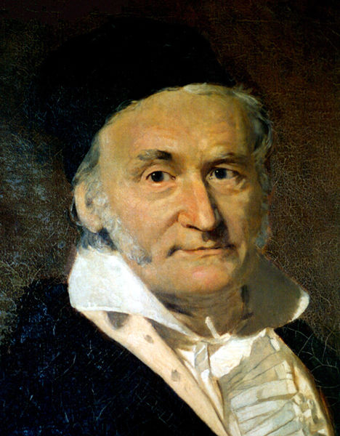
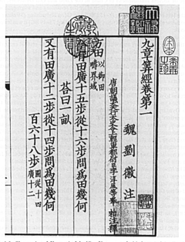
Solving Sets of Equations
150 B.C.E., 九章算術
Carl Friedrich Gauss, 1777-1855

Slide 2
Outline
Existence, uniqueness, and conditioning
Solving linear systems
Special types of linear systems
Software for linear systems

Slide 3
Systems of Linear Equations
Given m × n matrix A and m-vector b, find unknown n-vector x satisfying Ax=b
“Can b be expressed as linear combination of columns of A?”
If so, coefficients of linear combination are given by components of solution vector x
Solution may or may not exist, and may or may not be unique
For now, we consider only m=n

Slide 4
Nonsingularity and Singularity
An n × n matrix A is nonsingular if it has any of the following equivalent properties
Inverse of A, denoted by A⁻¹, exists
det(A)≠0
rank(A) = n
For any vector z ≠ 0, Az ≠ 0

Slide 5
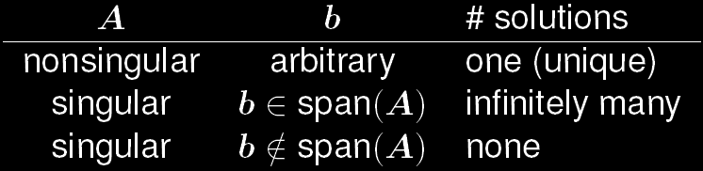
Existence and Uniqueness
Existence and uniqueness of solution to Ax = b depend on whether A is singular or nonsingular
Can also depend on b, but only in singular case

Slide 6
Geometric Interpretation
In two dimensions, each equation determines straight line in plane
Solution is the intersection point of two lines
If two straight lines are not parallel (nonsingular), then intersection point is unique

Slide 7
Geometric Interpretation (cont.)
If two straight lines are parallel (singular), then they either do not intersect (no solution) or else coincide (any point along line is a solution)
In higher dimensions, each equation determines a hyperplane; if a matrix is nonsingular, intersection of hyperplanes is a unique solution

Slide 8
Example: Nonsingularity
2 × 2 system or in matrix-vector notation is nonsingular regardless of value of b
For example, if b = [1, 11]^{T} then x = [1, 2]^{T} is a unique solution

Slide 9
Example: Singularity
2 × 2 system is singular regardless of value of b
With b = [1, 10]^{T}, there is no solution
With b = [1, -2]^{T}, x = [t, (5t+1)/3]^{T} is solution for any real number t, so there are infinitely many solutions

Slide 10
Solving Linear Systems
To solve a linear system, transform it into one whose solution is same but easier to compute
What type of transformation of linear system leaves solution unchanged?
We can premultiply (from left) both sides of a linear system Ax = b by any nonsingular matrix M without affecting its solution
Solution to MAx = Mb is given by x = (MA)⁻¹Mb = A⁻¹M⁻¹Mb = A⁻¹b

Slide 11
Example: Permutation Matrix
Permutation (or Transposition) matrix P has one 1 in each row and column and zeros elsewhere, i.e., identity matrix with rows or columns permuted
Note that P⁻¹ ⁼ P^{T}

Slide 12
Example: Permutation Matrix (cont.)
Premultiplying both sides of system by permutation matrix, PAx = Pb, reorder rows, but solution x is unchanged
Postmultiplying A by permutation matrix, APx = b, reorder columns, which permutes components of original solution x = (AP)⁻¹b = P⁻¹A⁻¹b = P^{T}(A⁻¹b)

Slide 13
Triangular Linear Systems
What type of linear system is easy to solve?
Notes:
If one equation in system involves only one component of solution
(i.e., only one entry in that row of matrix is nonzero), then that component
can be computed by division
2. If another equation in system involves only one additional component,
then by substituting one known component into it, we can solve for other component

Slide 14
Triangular Matrices
Two specific triangular forms are of particular interest
lower triangular: all entries above main diagonal are zero, a_{ij} = 0 for i < j
upper triangular: all entries below main diagonal are zero, a_{ij} = 0 for i > j

Slide 15
Forward Substitution
Forward substitution for lower triangular system Lx = b

Slide 16
Backward Substitution
Forward substitution for upper triangular system Ux = b

Slide 17
Elimination
We have learned using the elimination method to solve linear equations since high school!

Slide 18
Elimination (cont.)
What I’m going to show is just a systematical way to describe the process so that we can
handle n linear equations with n unknowns
develop an algorithm consisting of a series of matrix multiplications to solve a system of linear equations

Slide 19
Elimination (cont.)
To transform general linear system into a triangular form, we need to replace selected nonzero entries of matrix by zeros MA = L or MA = U
This can be done by taking linear combinations of rows
Let’s consider a column vector for now

Slide 20
Elimination (cont.)
Consider a 2-vector
If a₁ ≠ 0, then

Slide 21
Elementary Elimination Matrices
More generally, we can eliminate all entries below kth position in n-vector a by transformation
Divisor a_{k}, called pivot, must be nonzero
Notes:
Mk , kth column
For the i’th row, ai - mi*ak = 0 → mi = ai/ak; mk = 1

Slide 22
Elementary Elimination Matrices (cont.)
Matrix M_{k}, called elementary elimination matrix, adds multiple of row k to each subsequent row, with multipliers m_{i} chosen so that result is zero
Rows 1,…,k of matrix A are not affected!

Slide 23
Elementary Elimination Matrices (cont.)
Matrix M_{k}, called elementary elimination matrix, adds multiple of row k to each subsequent row, with multipliers m_{i} chosen so that result is zero
Rows 1,…,k of matrix A are not affected!

Slide 24
Elementary Elimination Matrices (cont.)
Matrix M_{k}, called elementary elimination matrix, adds multiple of row k to each subsequent row, with multipliers m_{i} chosen so that result is zero
Subsequent pre-multiplications of M_{k}‘s will not change the processed rows 1,…,k of matrix A

Slide 25
Elementary Elimination Matrices (cont.)
Matrix M_{k}, called elementary elimination matrix, adds multiple of row k to each subsequent row, with multipliers m_{i} chosen so that result is zero
Subsequent pre-multiplications of M_{k}‘s will not change the processed rows 1,…,k of matrix A
Not changed by M_{k+1}

Slide 26
Properties of Elementary Elimination Matrices
M_{k} is unit lower triangular and nonsingular
M_{k} = I – m_{k}e_{k}^{T}
M_{k}⁻¹ = I + m_{k}e_{k}^{T}
kth element
kth column

Slide 27
Gaussian Elimination
To reduce general linear system Ax = b to upper triangular form
First choose M₁ with a₁₁ as a pivot, to eliminate the 1st column of A below 1st row
System becomes M₁Ax = M₁b but solution is unchanged
Next choose M₂ using a₂₂ as pivot, to eliminate second column of M₁A below second row
System becomes M₂M₁Ax = M₂M₁b but solution is unchanged

Slide 28
Gaussian Elimination (cont.)
Process continues for each successive column until all subdiagonal entries have been zeroed
Resulting upper triangular linear system can be solved by back substitution to obtain solution to original linear system Ax = b
Process just described is called Gaussian Elimination

Slide 29
LU Factorization
U=MA is upper triangular
A=M⁻¹U
It can be proved that M⁻¹ is unit lower triangular
So we have with L unit lower triangular and U upper triangular
Gaussian elimination produces LU factorization of matrix into triangular factors
Notes:
Not all nonsingular matrices can be factorized as LU. Consider [0 2; 1 3], without pivoting, the nonsingular matrix cannot be decomposed as L*U!

Slide 30
Solving Ax = b by LU Factorization
Ax=b → LUx = b
Let y=Ux → Ly = b
Solve Ly = b by forward substitution
Solve Ux = y by back substitution
Note that y is the same as the transformed right-hand side in Gaussian elimination
Ux = Mb → y = Mb
Gaussian elimination and LU factorization are two ways of expressing the same solution process
Notes:
Ly = b
y = L^-1 * b = Mb (note that L = M^-1)

Slide 31
Using LU for multiple right-hand sides
If LU factorization of a matrix A is given, we can solve Ax = b for different b vectors as follows:
Ax = b → LUx = b
Solve Ly = b using forward substitution
Then solve Ux = y using backward substitution

Slide 32
Example: Gaussian Elimination
Use Gaussian elimination to solve linear system

Slide 33
Example: Gaussian Elimination (cont.)
To eliminate subdiagonal entry of second column of M₁A

Slide 34
Example: Gaussian Elimination (cont.)
We have reduced original system to equivalent upper triangular system which now can be solved by back substitution to obtain

Slide 35
Example: Gaussian Elimination (cont.)
To write out LU factorization explicitly,
Notes:
Ax = b
M2M1x = M2M1b
Ux = M2M1b
LUx = b
L = (M2M1)^-1 = (M1)^-1 (M2)^(-1)

Slide 36
Gaussian-Jordan Elimination
In Gauss-Jordan elimination, matrix is reduced to diagonal rather than triangular form
Row combinations are used to eliminate entries above as well as below diagonal

Slide 37
Gaussian-Jordan Elimination (cont.)
Elimination matrix used for a given column vector a is
Notes:
Mk , kth column
For the i’th row, ai - mi*ak = 0 → mi = ai/ak; mk = 1

Slide 38
Comparison with Gaussian Elimination

Slide 39
Solving Ax = b by Gaussian Jordan Elimination
Gauss-Jordan elimination requires about n³/2 multiplications and similar number of additions, 50% more expensive than LU factorization (see textbook)
diagonal matrix
Notes:
During elimination phase, the same row operations are also applied to right-hand-side vector (vectors) of system of linear equations
Once matrix is in diagonal form, components of solution are computed by dividing each entry of transformed right-hand side by corresponding diagonal entry of matrix

Slide 40
Row Interchanges
Gaussian elimination breaks down if a leading diagonal entry of a remaining unreduced matrix is zero at any stage
Easy fix: if a diagonal entry in column k is zero, then interchange row k with some subsequent row having a nonzero entry in column k and then proceed as usual

Slide 41
Row Interchanges (cont.)
If there is no nonzero entry on or below diagonal in column k, then there is nothing to do at this stage, so skip to next column
Zero on diagonal causes resulting upper triangular matrix to be singular, but LU factorization can still be completed
Subsequent back-substitution will fail; however, as it should for a singular matrix

Slide 42
Partial Pivoting
In principle, any nonzero entry can be a pivot, but in practice, a pivot should be chosen to minimize error propagation
To avoid amplifying previous rounding errors when multiplying the remaining portion of a matrix by an elementary elimination matrix, multipliers should not exceed 1 in magnitude
This can be accomplished by choosing the entry of the largest magnitude on or below diagonal as pivot at each stage

Slide 43
Partial Pivoting (cont.)
Partial pivoting is necessary in practice for numerically stable implementation of Gaussian elimination for general linear system

Slide 44
Example: Pivoting and Precision
Consider
Without pivoting

Slide 45
Example: Pivoting and Precision
With pivoting

